Slide 1

#ShapeRMIT project update, developing strategy and next steps: 1 September
1

Slide 2

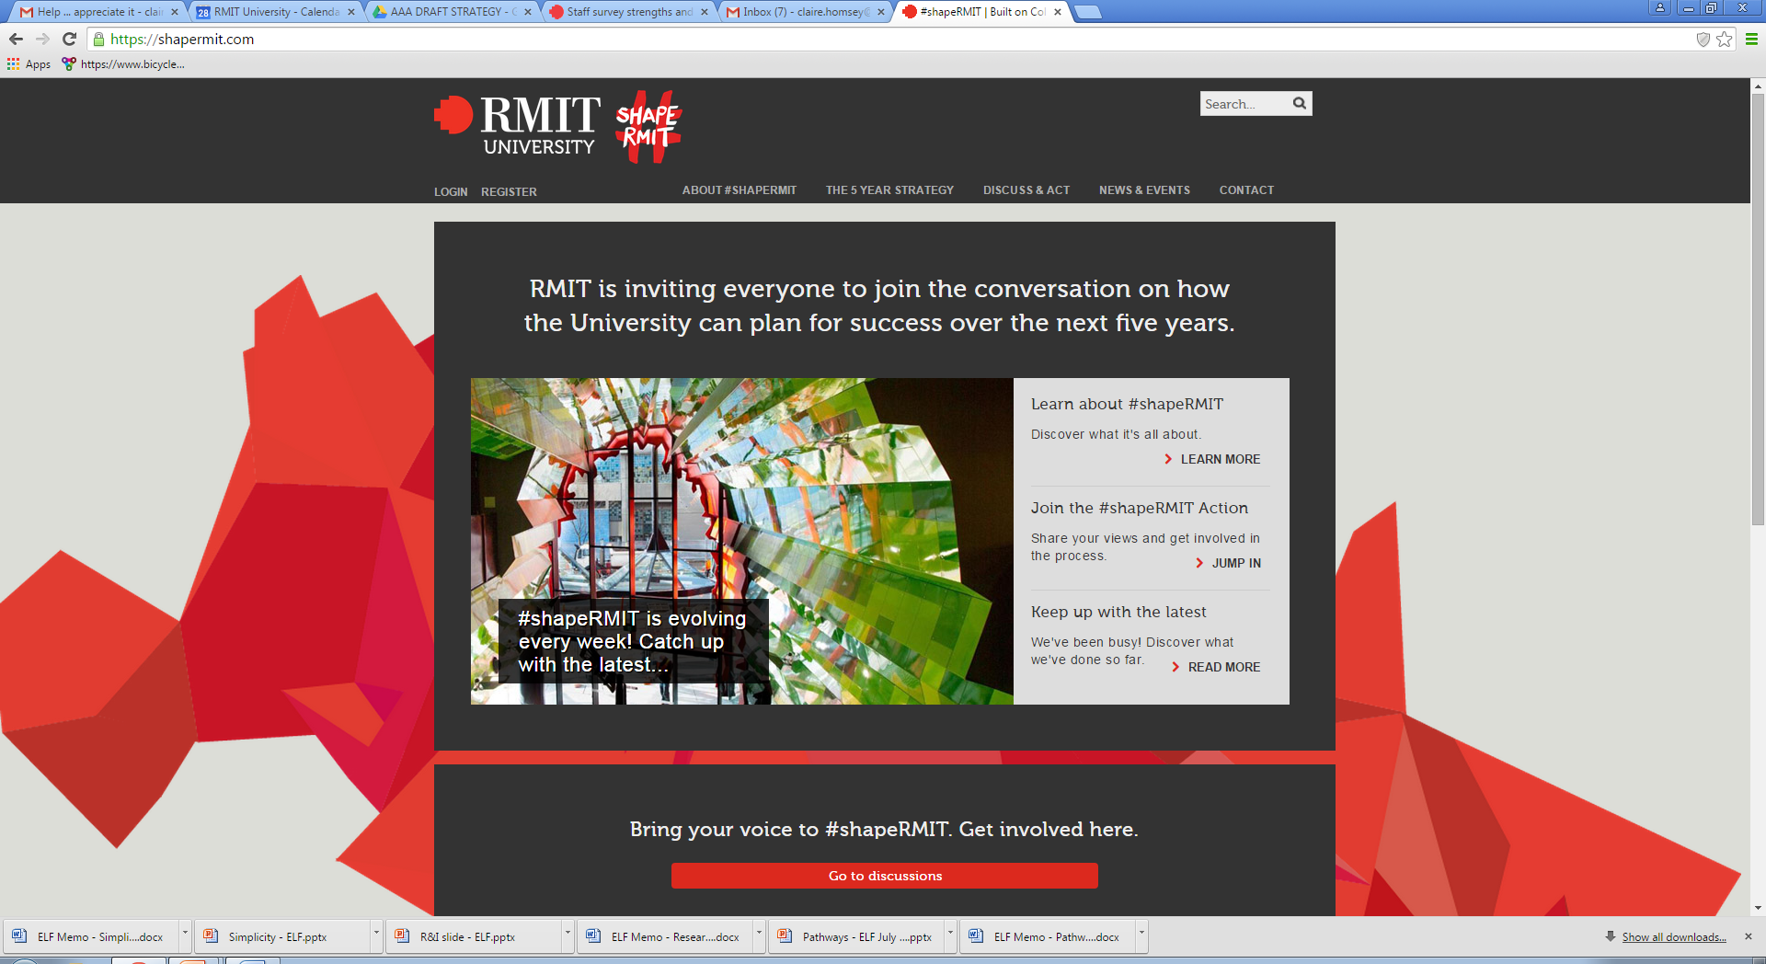
Objectives
It provides an update on the #shapeRMIT project and engagement so far and:
Outlines the #shapeRMIT Directions Paper and feedback received
Promotes opportunities for you and your colleagues to be involved in shaping RMIT
2
2
2
Notes:
Acknowledge Dennis Glover - writer

Slide 3
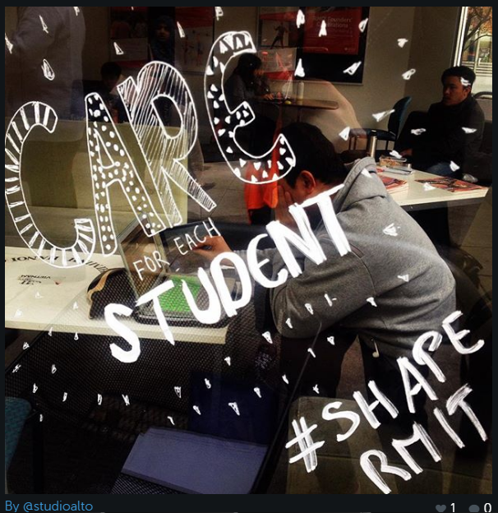
The journey so far
A wide-ranging engagement process to:
gather input broadly on ideas for the future
support the collaborative development of priorities
Online
The #shapeRMIT forum went live in April:
More than 800 people have joined the online discussions since June
Catalyst kit – online materials
Activities and events
Key events promote buy-in and engagement:
Workshops for staff and students
“5 for 5” – take five minutes to shape five years of RMIT
3

Slide 4
How are people telling us they want to #shapeRMIT?
(illustrative feedback)
“Research is extremely important for the universities; it shapes university image and reputation.”
“Employability is a key skill, one for the university to expose students to, rather than try and teach it.”
“Students are junior partners in a public institution and they are investing in their future and not just buying a qualification.”
“Keep class sizes manageable so students are appreciative of the opportunity they have and staff aren’t overworked and enjoy engaging with students.”
4

Slide 5
How are people telling us they want to #shapeRMIT?
(illustrative feedback)
“I would like to see RMIT seize the opportunity to restate its commitment to make the ‘public good’ of its research, teaching and learning…”
“Apply a global lens across everything we do to become a true multinational operation.”
“We are ‘industry facing’. The comment time and time again from potential employers and industry is that there is an ‘RMIT difference’.”
“Live up to the old motto of ‘a skilled hand and a cultivated mind’. RMIT has always been known for its graduates being job-ready – this needs to be re-emphasised.”
5

Slide 6

Live forum discussion
http://youtu.be/pEP7XoFVork
6

Slide 7

The developing strategy
7

Slide 8

#shapeRMIT Directions Paper
The Directions Paper is designed to:
Build on positive engagement
Set out the context for change
Build a common understanding of the issues and proposed directions
Test, refine and build support for ideas
Build ownership across the RMIT community for 2016 and beyond
8

Slide 9
The journey is creating positive momentum and engagement
Since the beginning of June when our new shapermit.com website launched:
More than 51,000 total page views
On 24 August (launch of the Directions Paper) there were:
7,948 page views
1,539 sessions
Users spent an average of 5 minutes and 12 seconds on shapermit.com
62.83 per cent of users were new visitors to the website
More than 4,700 total page views of the Directions Paper
9

Slide 10
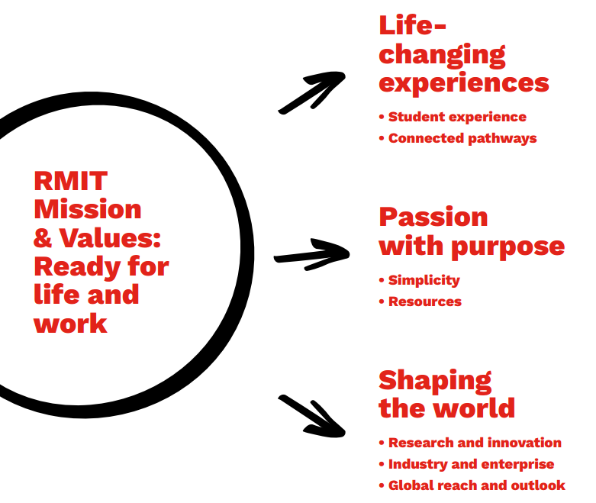
Three key directions enabled by goals
10

Slide 11
Direction 1: Life-changing experiences
Goal 1: A transformative student experience
RMIT gives a transformative experience to all students from all backgrounds. The experience integrates learning, campus, social and work connections.
Goal 2: Connected pathways
RMIT offers connected pathways between work and learning that support people to build compelling, personalised combinations of knowledge, skills and experience that prepare them better for life and work.
16
11

Slide 12
Direction 2: Passion with purpose
Goal 3: Supporting and empowering our people with clearer, smarter, simpler systems
RMIT supports its staff and associates to draw on their passions in pursuit of our shared goals: life-changing experiences, research and innovation that help shape the world for the better. In a complex world, we offer simple, supportive organisation and service.
Goal 4: Managing resources for sustained value
Our use of resources is driven by our goals. We create sustained value in our management of financial, physical, social and environmental resources.
17
12

Slide 13
Direction 3: Shaping the world
Goal 5: Research and innovation: creating impact through collaboration
We create knowledge and impact in diverse fields of human knowledge and need. We excel in applied, interdisciplinary research and we are active and influential in the wider innovation system.
Goal 6: Industry and enterprise embedded in everything we do
Our student experiences, research, staff and partnerships are connected to the leading edges of industry and enterprise.
Goal 7: Global reach and outlook
We are a leading global institution, successfully supporting innovative social and economic development in key urban centres around the world.
18
13

Slide 14

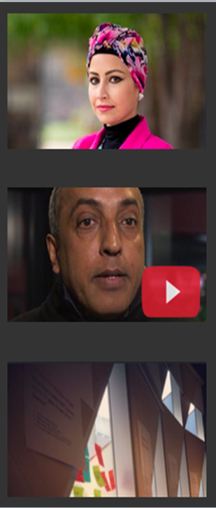
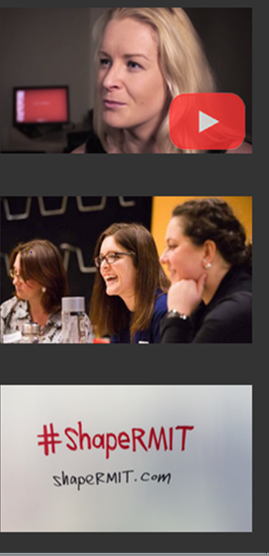

#shapeRMIT: Next steps
14
17

Slide 15


Directions Paper questions
GOAL 1) How can RMIT offer a transformative experience to students from all backgrounds?
GOAL 2) How can we develop clear, connected pathways which support students to achieve and integrate compelling outcomes in life and work?
GOAL 3) How should we simplify and improve the processes, systems and support that RMIT gives to its people?
GOAL 4) How should RMIT invest and manage its financial, material and environmental resources over the next five years?
GOAL 5) How should RMIT focus and increase the impact of our research and innovation?
GOAL 6) In what ways should RMIT further embed industry and enterprise in everything we do?
GOAL 7) What global priorities should we pursue for RMIT’s focus, presence and capabilities?
Contribute to these questions in the online discussions at https://discuss.shapermit.com/g/3sbY8J7M/directions-paper
15

Slide 16
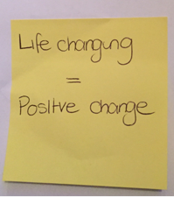
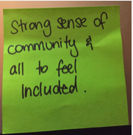
Key dates
21 August | Directions Paper launch
September | 18 September – Directions Paper consultation closes Drafting and testing the thinking
November - December | Launch
16

Slide 17

The whole RMIT community can #shapeRMIT
#shapeRMIT online forum:
Join the conversation
Directions Paper - comment boxes and discussion group online
Catalyst kit – materials online to help you conduct workshops
“5 for 5” – take 5 minutes to shape 5 years
Email the project team at shape.rmit@rmit.edu.au
Go to shapermit.com for further information
17

